Slide 1
Identifying at-risk students in undergraduate courses

Slide 2
Agenda
Problem
Motivation
Data collection
Model Training
Inference pipeline
Dashboard
Results/Impact
Challenges
Questions and Discussion

Slide 3
Problem
To identify at-risk students in entry-level critical courses like calculus and Biology.
High dropout rates from school due to failure in above courses.
Hence, need to identify at-risk students in courses and help them succeed.

Slide 4
Motivation
High Impact
Students come from various diverse and economic backgrounds and it is necessary to identify their struggles and help them achieve their goals.
Potential to be implemented across courses at ASU.

Slide 5





Data Collection
Student information system (SIS)
Activity data
Student pre-placement data

Slide 6
Model Training
Goal
Model with High recall and precision ( Need to identify as much as at-risk students as possible)
False negative is costlier than False positive.
Steps:
Merge data from all the sources
Data cleaning -> checking for null values, outliers
EDA - checking for patterns wrt Age, Part_time and success of a student, correlation plots
Feature engineering
Modeling - using classification models like Logistic, Random forest and XGBoost
Hyperparameter tuning
Results

Slide 7



Inference Pipeline

Slide 8
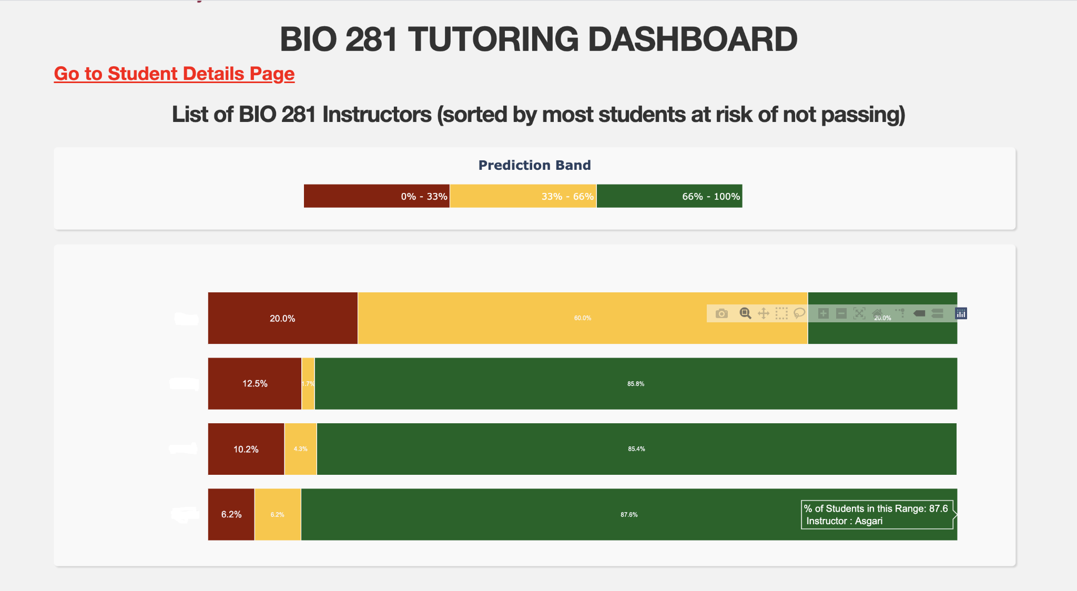
Dashboard
Instructor A
Instructor B

Slide 9
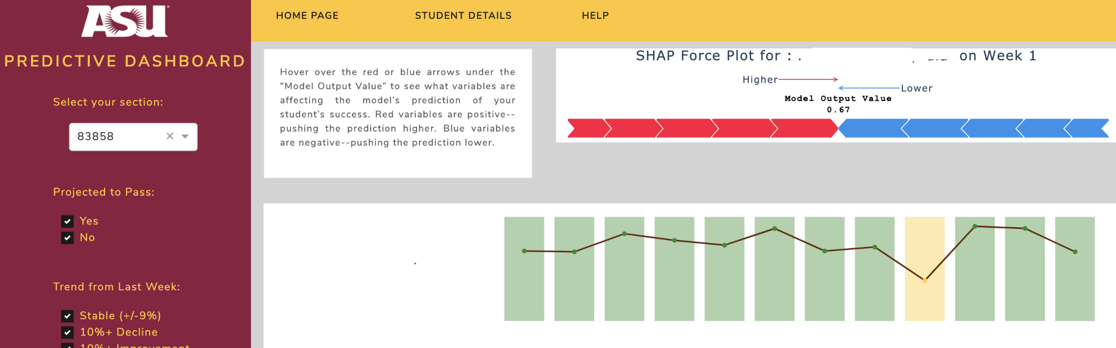
Dashboard
Student A
Student A
(graph shows probabilities of success)
Weeks

Slide 10
Results and Impact
Model recall ~ 80% and precision ~ 90% by week 5-6 in a 15-week course
Threshold for the model could be varied and model recall could be increased based on resources available.
8% increase in success rate in MAT 117 course in Spring 2021 wrt Spring 2020.

Slide 11
Challenges
Data drift due to COVID
Explainability
Chances of model bias wrt Gender, Ethnicity
Need to secure PII data - not to leak any important personal data

Slide 12
THANK YOU

